Slide 1

16-bit Adder with Manchester Carry Ahead
PRESENTED BY
SUPERVISED BY
• Ashikur Rahman Bhi (ID: ET193069)
• Chowdhury Arap Mahamud Recap (ID: ET193068)
• Pranta Paul (ID: ET193089)
Engr. Riazul Islam
Lecturer
Department of Electrical & Electronic Engineering
International Islamic University Chittagong (IIUC)

Slide 2
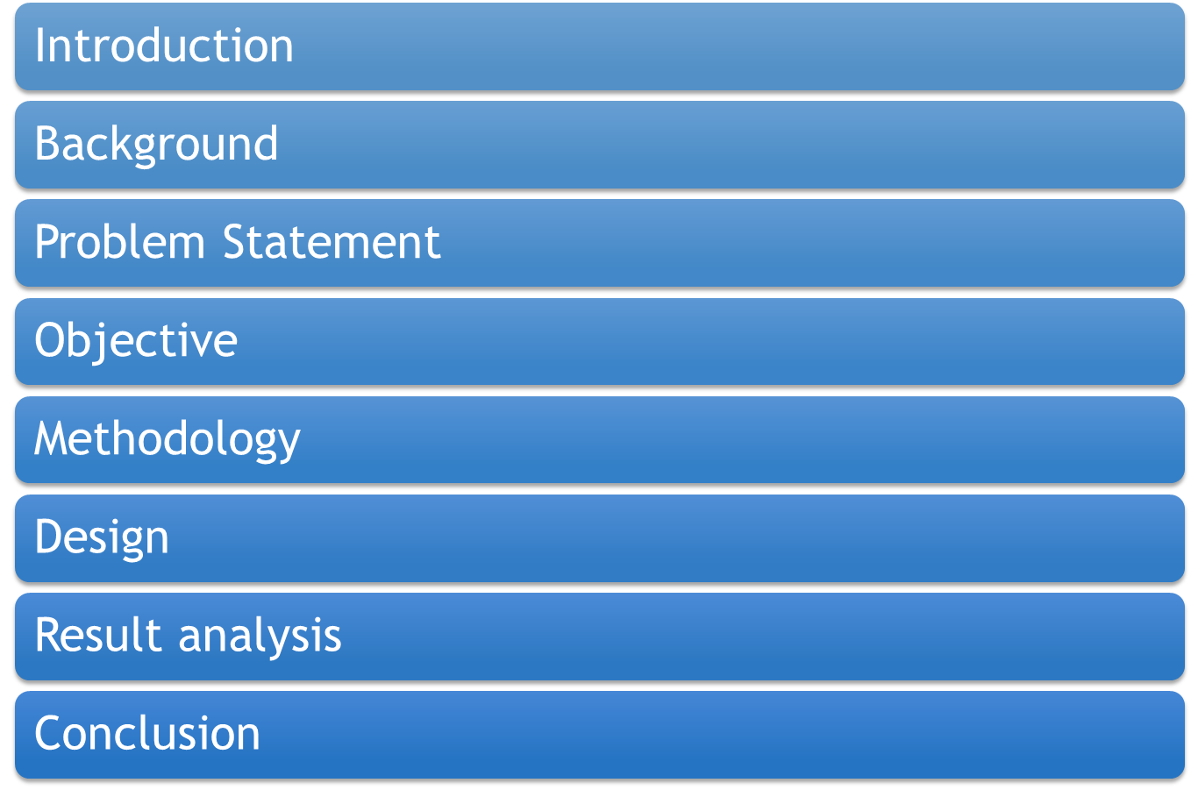
DEPARTMENT OF EEE, IIUC | B.Sc. THESIS PRESENTATION
Presentation Overview & Outline
Presentation Roadmap
16-bit Adder with Manchester Carry Ahead | Department of EEE, IIUC
Slide 2

Slide 3
DEPARTMENT OF EEE, IIUC | B.Sc. THESIS PRESENTATION
1. INTRODUCTION
Background & Importance of Adders
• Fundamental Arithmetic Block:
Adders are fundamental building blocks in digital electronics and computing. They are circuits designed to perform binary addition, the core operation behind most arithmetic functions in digital systems. Adders are not only essential for simple calculations but also serve as the foundation for more complex arithmetic operations, such as subtraction, multiplication, and division, which are widely used in various applications like media signal processing, computer processors, and embedded systems.
• High-Performance VLSI Demand:
As technology evolves, there is a growing emphasis on designing faster, smaller, and more energy-efficient adders to meet the demands of modern computing. From the basic Half Adder (HA) to more advanced structures like the Carry Look-Ahead Adder (CLA) and Kogge-Stone Adder (KSA), various adder architectures have been developed to optimize speed, area, and power consumption.
• Scope of Presentation:
In this presentation, we explore different types of adders, their operation, and their significance in modern digital systems, along with the challenges and innovations in designing efficient adder circuits.
16-bit Adder with Manchester Carry Ahead | Department of EEE, IIUC
Slide 3

Slide 4
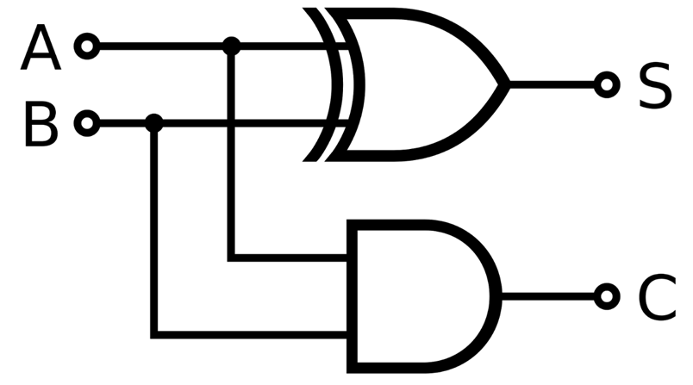
DEPARTMENT OF EEE, IIUC | B.Sc. THESIS PRESENTATION
2. BACKGROUND: Half Adder (HA) Architecture
Half Adder Concept & Truth Table
Half Adder Logic Diagram
A basic adder known as the Half Adder (HA) performs simple binary addition of two input bits using just an XOR gate (for the sum) and an AND gate (for the carry). The structure and behavior of a half adder can be understood through its logic circuit and accompanying truth table.
A | B | Sum (S) | Carry (C)
0 | 0 | 0 | 0
0 | 1 | 1 | 0
1 | 0 | 1 | 0
1 | 1 | 0 | 1
Table 1: The truth table of a Half Adder
Fig 01: Half Adder design
16-bit Adder with Manchester Carry Ahead | Department of EEE, IIUC
Slide 4

Slide 5
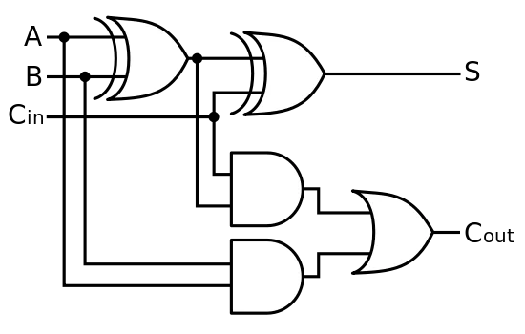
DEPARTMENT OF EEE, IIUC | B.Sc. THESIS PRESENTATION
2. BACKGROUND: Full Adder (FA) Architecture
Full Adder Concept & Truth Table
Full Adder Logic Circuit
By combining two Half adders together, we can process the outputs of the Carry along with the sum for multi-bit binary addition.
A | B | Cin | S | C
0 | 0 | 0 | 0 | 0
0 | 0 | 1 | 1 | 0
0 | 1 | 0 | 1 | 0
0 | 1 | 1 | 0 | 1
1 | 0 | 0 | 1 | 0
1 | 0 | 1 | 0 | 1
1 | 1 | 0 | 0 | 1
1 | 1 | 1 | 1 | 1
Fig 02: Full Adder design
Table 2: The truth table of a Full Adder
16-bit Adder with Manchester Carry Ahead | Department of EEE, IIUC
Slide 5

Slide 6
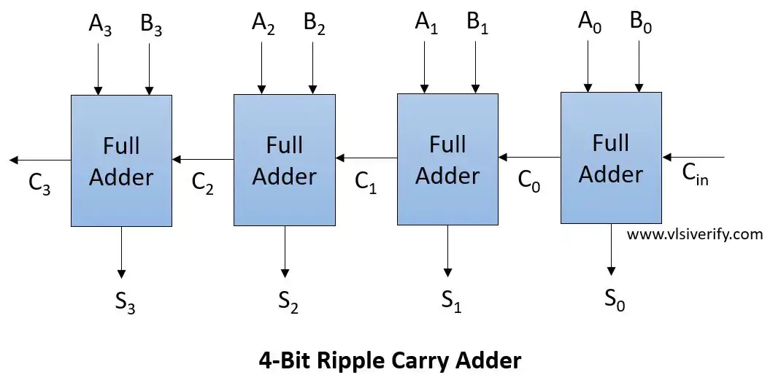
DEPARTMENT OF EEE, IIUC | B.Sc. THESIS PRESENTATION
2. BACKGROUND: Ripple Carry Adder (RCA)
RCA Operation & Limitations
Ripple Carry Adder Circuit Diagram
• Cascaded Full Adders:
By combining Full Adders in series, we can calculate the sum of n-bit numbers. However, it is a slow method as each bit must process sequentially.
• Delay Bottleneck in RCA:
To calculate the most significant bit (MSB), we must wait for the carry signal to propagate all the way from the least significant bit (LSB). This carry propagation delay limits high-speed multiplication and ALU performance.
Fig 03: Ripple carry Adder design
16-bit Adder with Manchester Carry Ahead | Department of EEE, IIUC
Slide 6

Slide 7
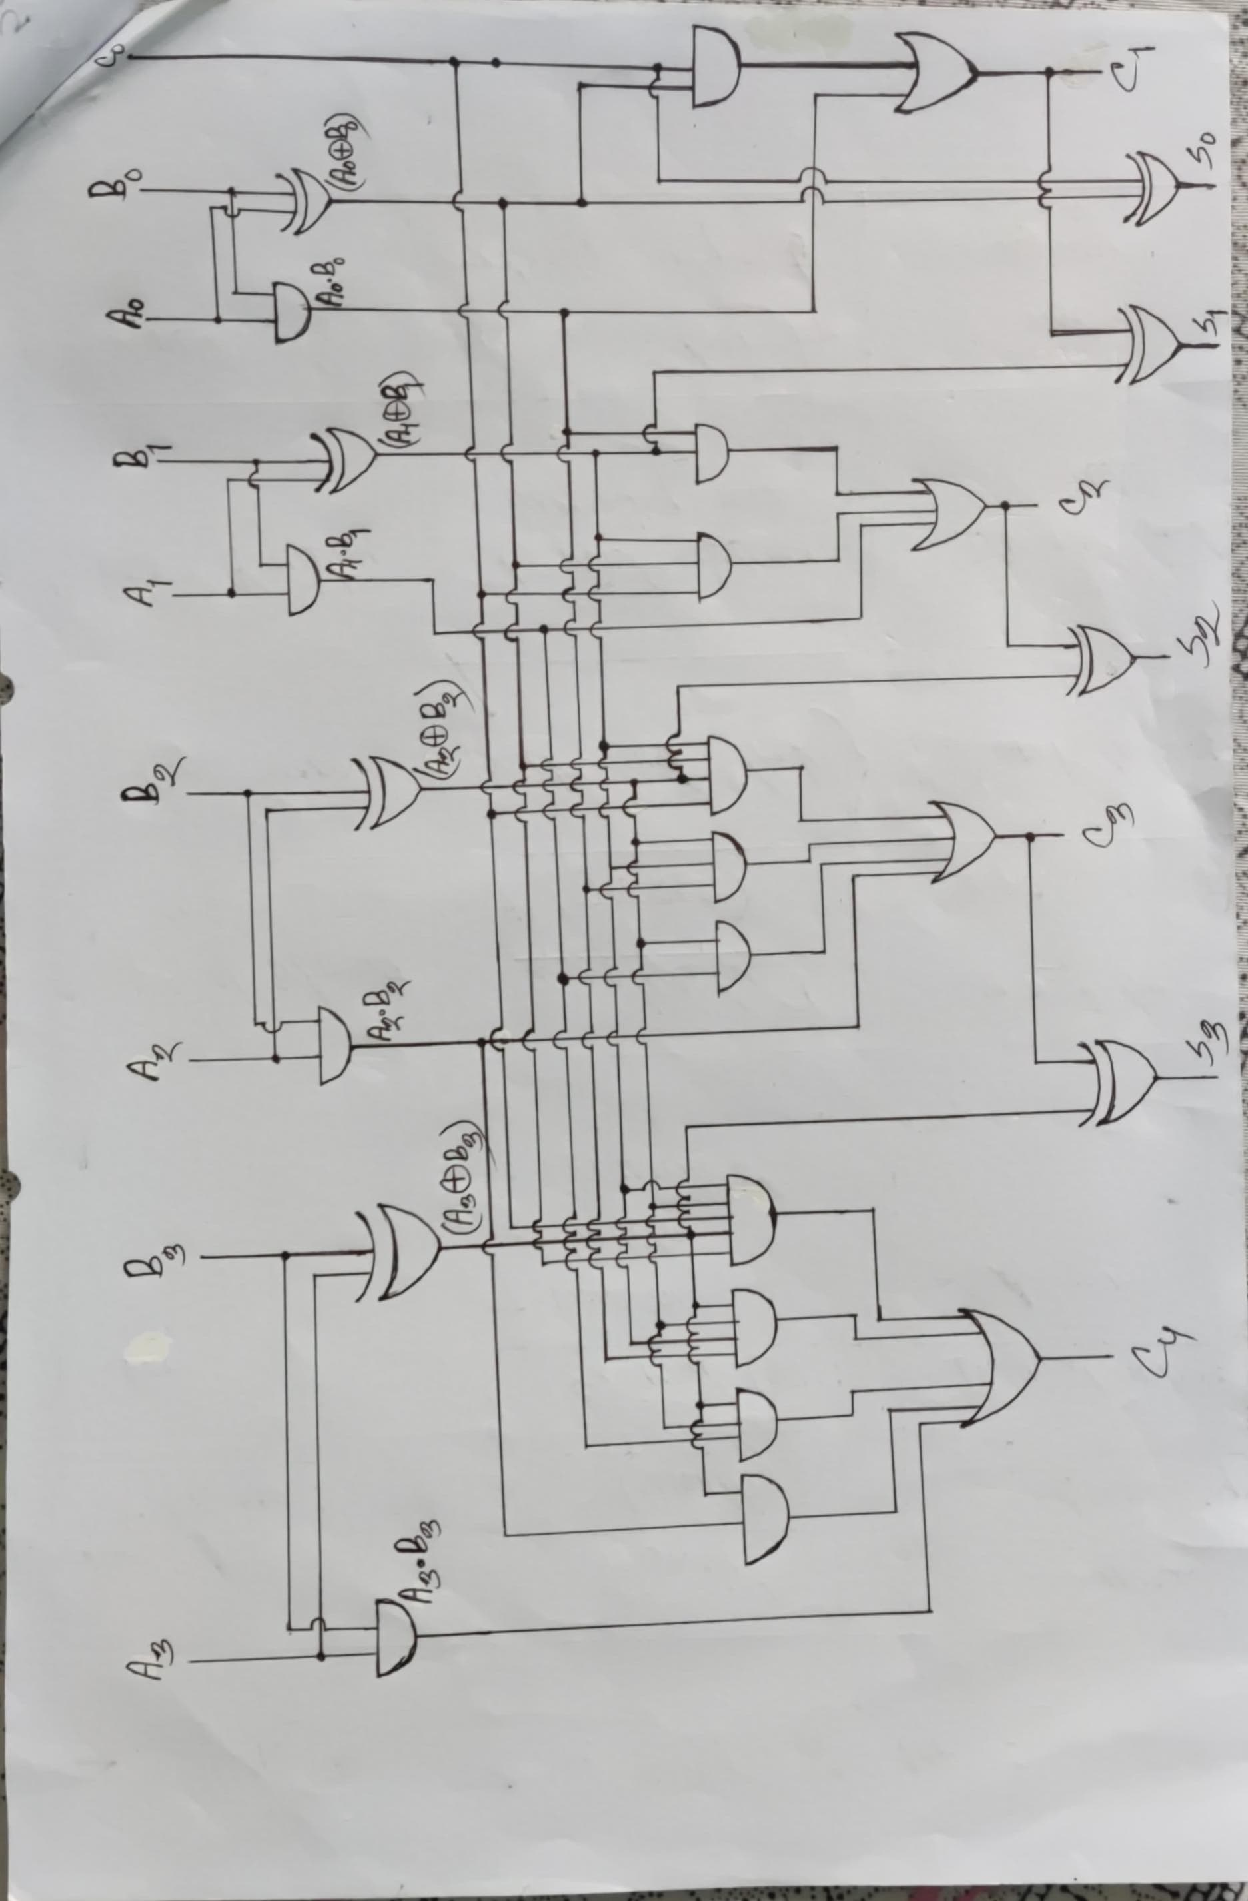

DEPARTMENT OF EEE, IIUC | B.Sc. THESIS PRESENTATION
2. BACKGROUND: Carry Look-Ahead (CLA) Block
CLA Carry Calculation Block
CLA Parallel Speed Advantage
• Fast Carry Generation:
The circuit shown in Fig 4 calculates carry signals separately and in parallel.
• Reduced Latency:
By doing so, we calculate the sum much faster than the ripple carry adder because bits do not need to wait for sequential propagation.
Fig 04: Carry Look Ahead Carry Calculation Block
16-bit Adder with Manchester Carry Ahead | Department of EEE, IIUC
Slide 7

Slide 8
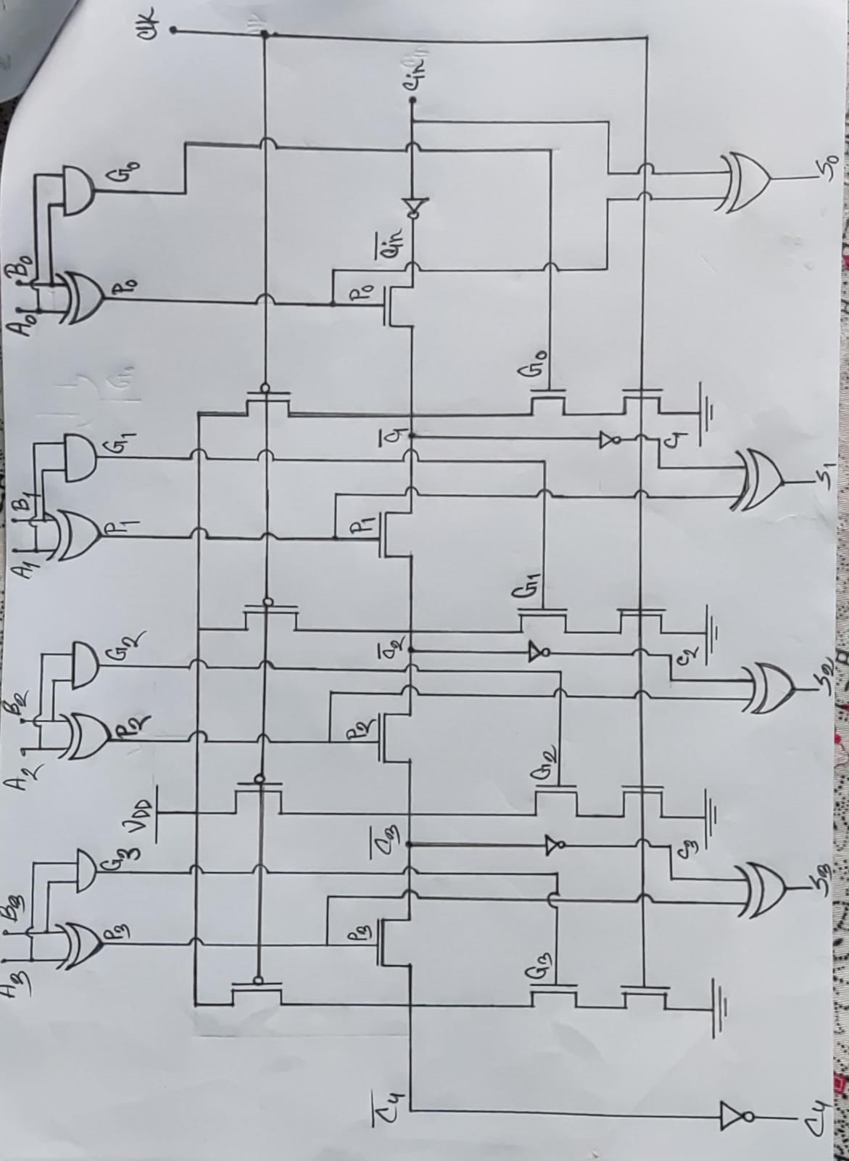
DEPARTMENT OF EEE, IIUC | B.Sc. THESIS PRESENTATION
2. BACKGROUND: Manchester Carry Adder
Conventional Manchester Carry Circuit
Manchester Carry Features
• Direct Switch Logic:
Calculates carry separately using pass-transistor switch chains.
• Gate Elimination:
Differs from standard CLA by avoiding heavy static logic gates in the carry chain, reducing gate count and power.
Fig 05: Conventional Manchester Carry Adder Carry Calculation
16-bit Adder with Manchester Carry Ahead | Department of EEE, IIUC
Slide 8

Slide 9
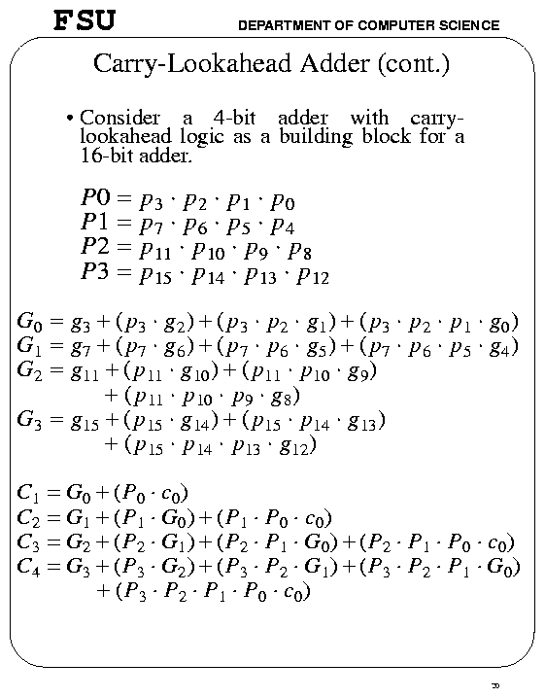
DEPARTMENT OF EEE, IIUC | B.Sc. THESIS PRESENTATION
2. BACKGROUND: Parallel Carry Generation Principles
Carry Generation Formulas
Parallel Computation Significance
• Simultaneous Carry Calculation:
Instead of waiting for each carry to be produced sequentially (as in ripple-carry addition), all carries are computed in parallel using closed-form logic expressions.
• Essential for High-Speed CPUs:
Carry Look-Ahead calculation is essential for building fast arithmetic logic units (ALUs) found in modern microprocessors and digital signal processors (DSPs), improving overall system clock rates.
16-bit Adder with Manchester Carry Ahead | Department of EEE, IIUC
Slide 9

Slide 10
DEPARTMENT OF EEE, IIUC | B.Sc. THESIS PRESENTATION
3. LITERATURE REVIEW: Prior Art Comparison
Summary of Literature Contributions & Limitations
Researcher(s) | Year | Contribution | Drawbacks / Limitations
Padmanabhan Balasubramanian & Nikos E. Mastorakis [1] | 2022 | Use of CLA Adder for an advanced high-speed design | Uses static logic gates which are more complex and power-heavy.
Vellingiri GOVINDARAJ, Ezhılazhagan CHENGUTTUVAN, Dhanasekar SUBRAMANIYAM [2] | 2022 | Use of CSKA Adder for a FIR filter design using block bypass. | Employs Ripple Carry Adder blocks with logic gates, resulting in slow speed.
P Das, A L Bhalerao, A Mane, A Angeline A, V S K Bhaaskaran [3] | 2019 | Use of Manchester carry adder with High-Speed Domino (HSD) logic. | The design does not incorporate any multi-level carry bypass system.
16-bit Adder with Manchester Carry Ahead | Department of EEE, IIUC
Slide 10

Slide 11
DEPARTMENT OF EEE, IIUC | B.Sc. THESIS PRESENTATION
4. PROBLEM STATEMENT
01
Reduce Power Consumption
Conventional 16-bit adders exhibit high dynamic and static power dissipation due to redundant switching and heavy gate counts.
02
Reduce Rise Time and Fall Time
Long signal propagation delays in traditional carry chains increase rise/fall times, creating performance bottlenecks at higher frequencies.
03
Reduce Circuit Complexity
Complex logic gate structures increase transistor count, layout footprint, and routing parasitic capacitance.
16-bit Adder with Manchester Carry Ahead | Department of EEE, IIUC
Slide 11

Slide 12
DEPARTMENT OF EEE, IIUC | B.Sc. THESIS PRESENTATION
5. RESEARCH OBJECTIVES
01
Novel Hybrid Adder Design
Develop a new 16-bit adder design utilizing existing Manchester Carry and bypass techniques to minimize critical path delay.
02
Rise & Fall Time Optimization
Significantly improve rise time and fall time dynamics through optimized transistor sizing and multi-level bypass paths.
03
Power & Energy Characterization
Rigorously calculate and analyze total power consumption and power-delay product (PDP) across nanometer nodes.
16-bit Adder with Manchester Carry Ahead | Department of EEE, IIUC
Slide 12

Slide 13
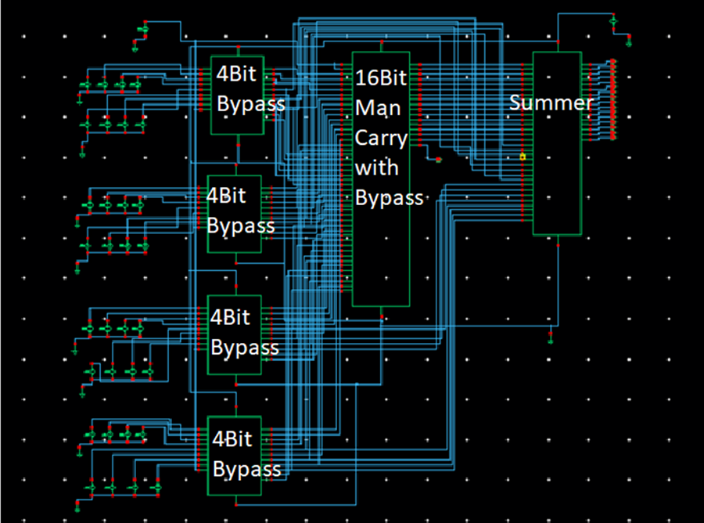
DEPARTMENT OF EEE, IIUC | B.Sc. THESIS PRESENTATION
6. METHODOLOGY: Overall System Architecture
16-Bit Adder Architecture Diagram
System Integration
• Component Hierarchy:
The overall system block diagram contains the various modular cell components of the proposed 16-bit Manchester Carry Adder.
• Modular Design:
Combines Type I, Type II, Type III, Type IV cells, Domino logic, and summer stages for high-speed operation.
Fig 06: System Block Diagram
16-bit Adder with Manchester Carry Ahead | Department of EEE, IIUC
Slide 13

Slide 14
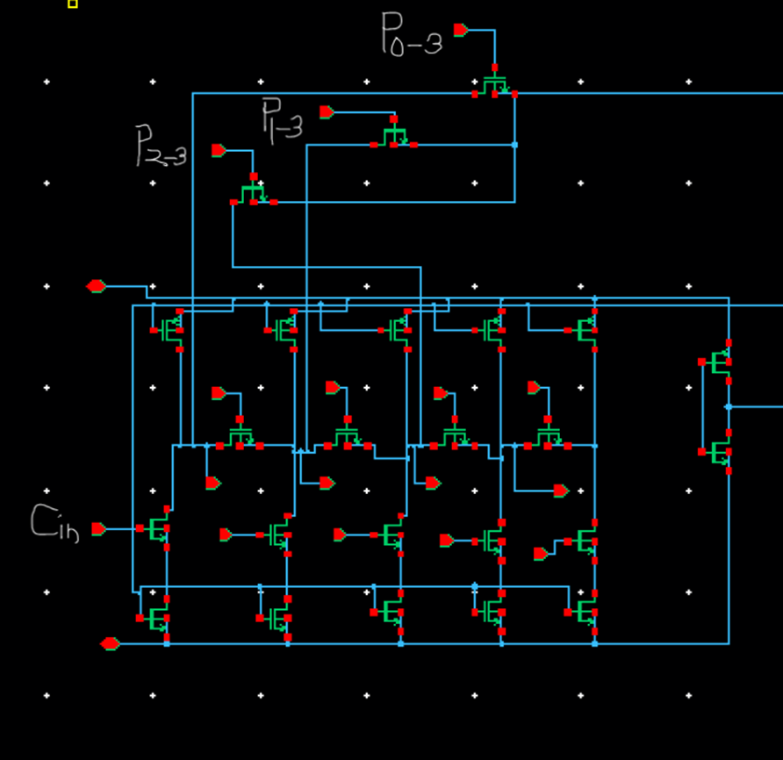
DEPARTMENT OF EEE, IIUC | B.Sc. THESIS PRESENTATION
6. METHODOLOGY: Type I Cell Circuit
Type I Cell Transistor Schematic
Type I Cell Operation
• Transistor Structure:
The Type I cell incorporates one intercell and two intracell bypass transistors, specifically P0-3, P1-3, and P2-3.
• Swift Carry Propagation:
The presence of P0-3 enables the carry input Cin to propagate swiftly to the Type II cell, bypassing intermediate nodes.
Fig 07: Type I Cell
16-bit Adder with Manchester Carry Ahead | Department of EEE, IIUC
Slide 14

Slide 15
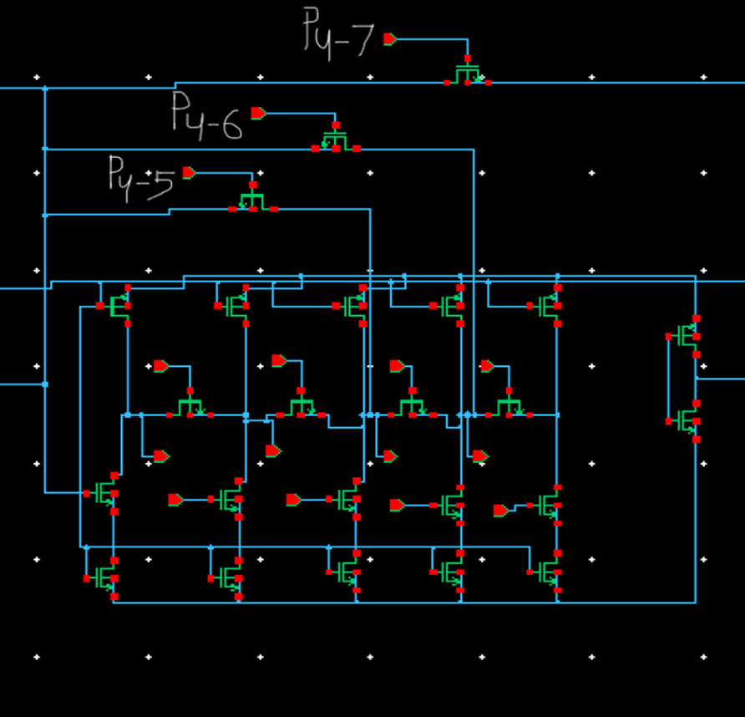
DEPARTMENT OF EEE, IIUC | B.Sc. THESIS PRESENTATION
6. METHODOLOGY: Type II Cell Structure
Type II Cell Transistor Schematic
Type II & Type III Topology
• Shared Topology:
Topologically, the Type II and Type III cells share the same structure; their main distinction lies in transistor sizing.
• Carry-Skip Function:
Transistors P8-11 enable standard carry-skip across bit blocks whenever all propagate signals within the block are high.
Fig 08: Type II Cell
16-bit Adder with Manchester Carry Ahead | Department of EEE, IIUC
Slide 15

Slide 16
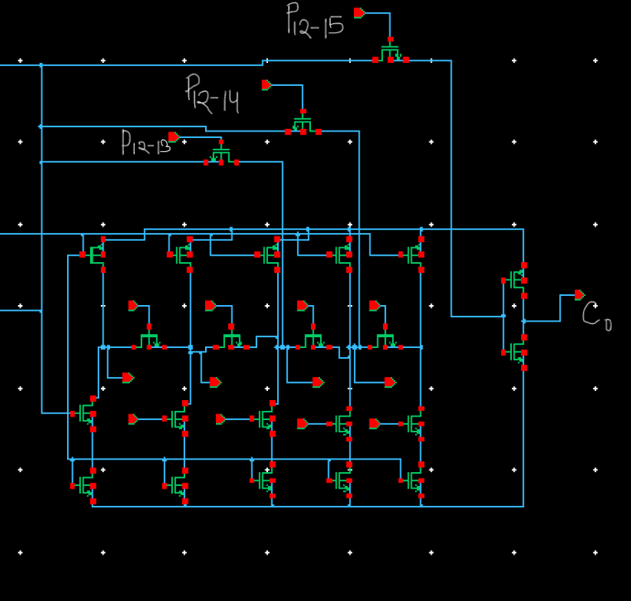
DEPARTMENT OF EEE, IIUC | B.Sc. THESIS PRESENTATION
6. METHODOLOGY: Type IV Cell Structure
Type IV Cell Transistor Schematic
Type IV Cell Distinctions
• Sizing & Bypass Placement:
The Type IV cell differs from Type II and Type III cells in both transistor sizing and placement of the intercell bypass transistor P_(12-15).
• Block Skip Execution:
Transistor P_(12-15) performs the usual skip action on blocks of bits when all propagate signals into the blocks are high.
Fig 09: Type IV Cell
16-bit Adder with Manchester Carry Ahead | Department of EEE, IIUC
Slide 16

Slide 17
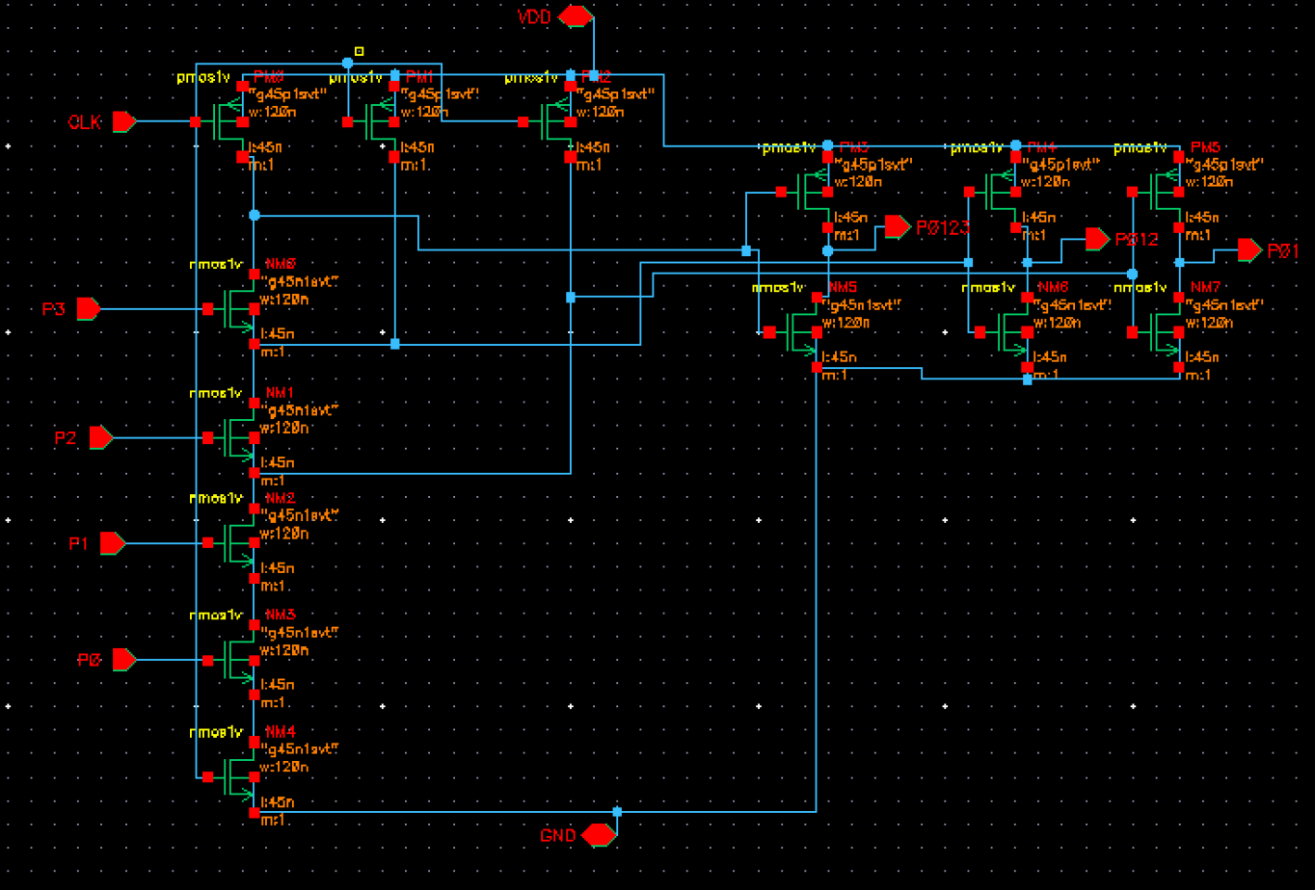
DEPARTMENT OF EEE, IIUC | B.Sc. THESIS PRESENTATION
6. METHODOLOGY: Multiple-Output Domino Logic Gate
Multiple-Output Domino Logic Schematic
Propagate Control Generation
• Control Signal Generation:
The intercell and intracell bypass transistors are controlled by signals Pi-j.
• High-Speed Domino Gate:
These control signals are generated by a high-speed multiple-output domino logic gate, minimizing area and driver delay.
Fig 10: Multiple-output domino logic gate used to compute P_(i-j)
16-bit Adder with Manchester Carry Ahead | Department of EEE, IIUC
Slide 17

Slide 18
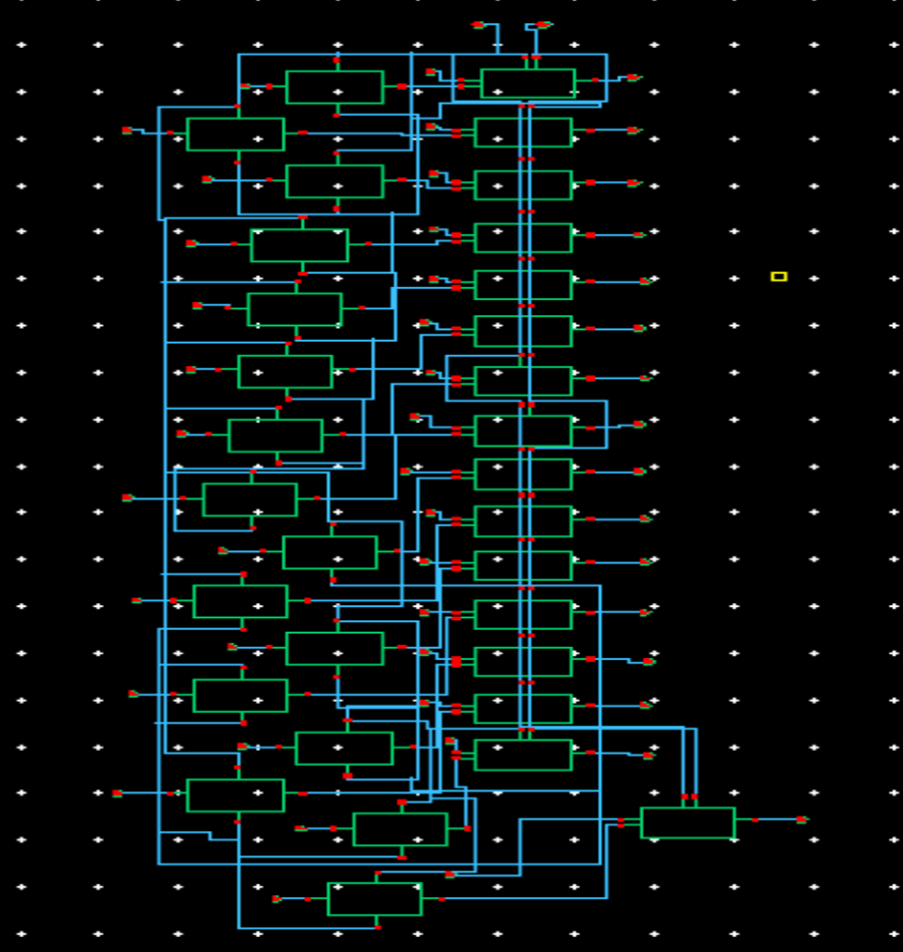
DEPARTMENT OF EEE, IIUC | B.Sc. THESIS PRESENTATION
6. METHODOLOGY: Summer Circuit Architecture
Summer Circuit Schematic Diagram
Independent Sum Generation
• Carry & Generate Combination:
The carry signal is combined with the generate output of the half adder to obtain the final sum.
• Independent Sum Computation:
Each block has its bypass signal. By bypassing the carry and utilizing a summer circuit, the sum output is computed fast and independently.
Fig 11: Summer Circuit used in design
16-bit Adder with Manchester Carry Ahead | Department of EEE, IIUC
Slide 18

Slide 19
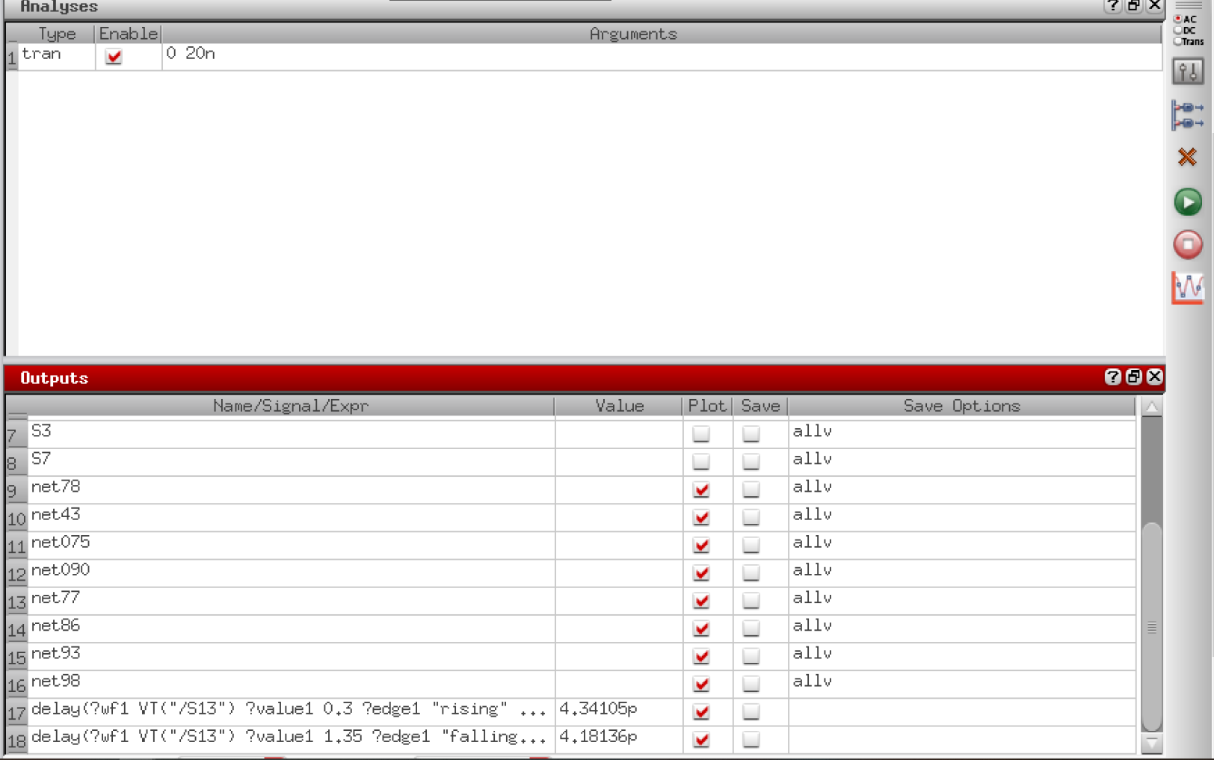
DEPARTMENT OF EEE, IIUC | B.Sc. THESIS PRESENTATION
7. IMPLEMENTATION: Cadence Simulation Setup
Cadence Simulation Parameters & Analysis
Simulation Environment
This figure displays the Cadence Virtuoso simulation configuration, transient analysis settings, and model parameter setups for the 16-bit adder design.
Fig 12: Simulation parameters and analysis type
16-bit Adder with Manchester Carry Ahead | Department of EEE, IIUC
Slide 19

Slide 20
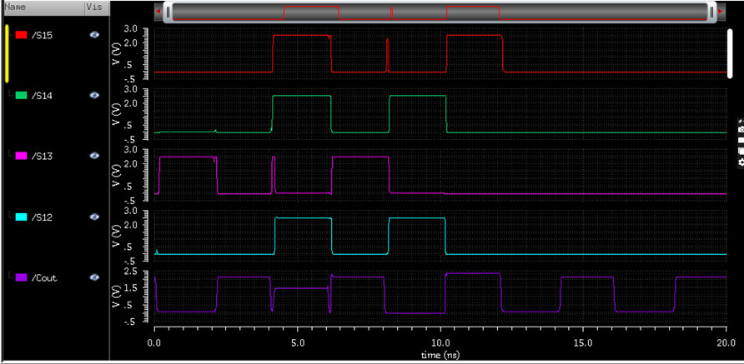
DEPARTMENT OF EEE, IIUC | B.Sc. THESIS PRESENTATION
8. SIMULATION: Sum Output Waveforms
Transient Simulation Waveforms (Bits 12-15)
Waveform Analysis
Sum Output waveform of the 16-bit adder corresponding to bits 12 through 15 during high-frequency transient simulation.
Fig 09: Sum Output of Adder from simulation
16-bit Adder with Manchester Carry Ahead | Department of EEE, IIUC
Slide 20

Slide 21
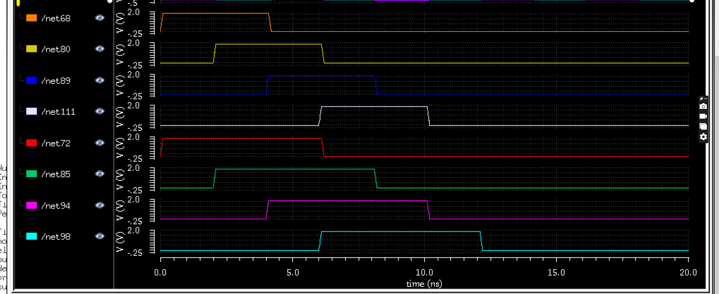
DEPARTMENT OF EEE, IIUC | B.Sc. THESIS PRESENTATION
8. SIMULATION: Input Test Signals
Input Waveform Vectors for Bits 12 to 15
Fig 10: Input Signals for Adder (bits 12 to 15 corresponding to output waveforms)
16-bit Adder with Manchester Carry Ahead | Department of EEE, IIUC
Slide 21

Slide 22
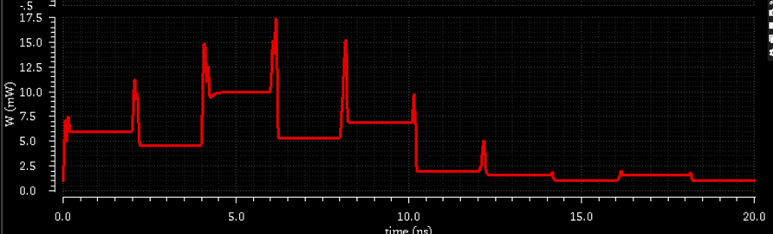
DEPARTMENT OF EEE, IIUC | B.Sc. THESIS PRESENTATION
8. SIMULATION: Instantaneous Power Consumption
Power Waveform Graph & Dynamic Fluctuations
Fig 11: Output of the power Consumption of the circuit. The fluctuations represent dynamic switching during peak logic operations.
16-bit Adder with Manchester Carry Ahead | Department of EEE, IIUC
Slide 22

Slide 23
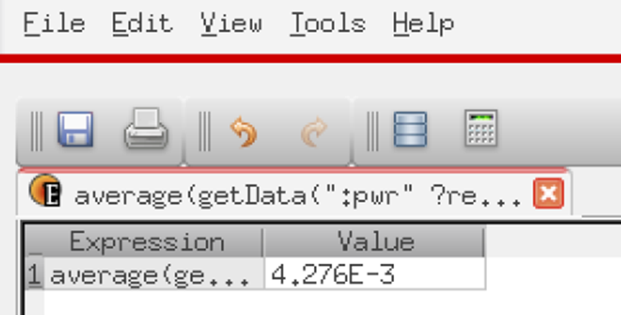
DEPARTMENT OF EEE, IIUC | B.Sc. THESIS PRESENTATION
9. RESULT ANALYSIS: Average Power Calculation
Cadence Calculator Average Power Measurement
Fig 12: Average Power Output measured using Cadence Virtuoso Calculator function.
16-bit Adder with Manchester Carry Ahead | Department of EEE, IIUC
Slide 23

Slide 24

DEPARTMENT OF EEE, IIUC | B.Sc. THESIS PRESENTATION
9. RESULT ANALYSIS: Rise & Fall Time Metrics
Cadence Calculator Rise and Fall Time Analysis
Fig 13: Rise Time and Fall Time measurements displayed directly from the Cadence main interface calculator.
16-bit Adder with Manchester Carry Ahead | Department of EEE, IIUC
Slide 24

Slide 25
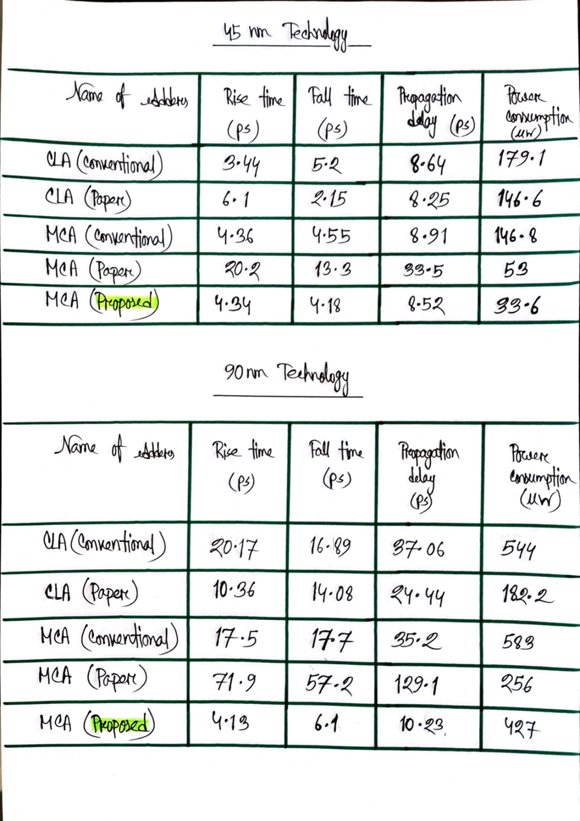
DEPARTMENT OF EEE, IIUC | B.Sc. THESIS PRESENTATION
10. PERFORMANCE COMPARISON: 45nm Technology Node
Table 1: Performance Comparison of Various Adders (45nm)
16-bit Adder with Manchester Carry Ahead | Department of EEE, IIUC
Slide 25

Slide 26

DEPARTMENT OF EEE, IIUC | B.Sc. THESIS PRESENTATION
10. PERFORMANCE COMPARISON: 90nm Technology Node
Table 2: Performance Comparison of Various Adders (90nm)
16-bit Adder with Manchester Carry Ahead | Department of EEE, IIUC
Slide 26

Slide 27
DEPARTMENT OF EEE, IIUC | B.Sc. THESIS PRESENTATION
11. CONCLUSION & SUMMARY
Concluding Remarks
• Optimization Significance:
As technology advances and the demand for high-performance, low-power systems continues to grow, optimizing adder designs becomes increasingly critical. Understanding the strengths and limitations of various adder types enables engineers to make informed architectural decisions when developing processors, DSPs, and modern digital ICs.
• Enabling Next-Gen Computing:
Ultimately, mastering adder design is not just about improving basic arithmetic operations—it is about enabling faster, smarter, and more energy-efficient computing architectures for the future.
16-bit Adder with Manchester Carry Ahead | Department of EEE, IIUC
Slide 27

Slide 28
DEPARTMENT OF EEE, IIUC | B.Sc. THESIS PRESENTATION
12. REFERENCES
Key Literature References
[1] P. Das, A. L. Bhalerao, A. Mane, A. A Angeline, and V. S. K. Bhaaskaran, "Design of Manchester Carry Chain Adder using High speed Domino Logic," IOP Conference Series: Materials Science and Engineering, vol. 561, no. 1, p. 012125, Oct. 2019, doi: 10.1088/1757-899X/561/1/012125.
[2] G. V, E. CHENGUTTUVAN, and D. SUBRAMANIYAM, "Design of Power and Area Efficient Carry Skip Adder and FIR filter Implementation," El-Cezeri Fen ve Mühendislik Dergisi, Dec. 2022, doi: 10.31202/ecjse.1162711.
[3] P. Balasubramanian and N. E. Mastorakis, "High-Speed and Energy-Efficient Carry Look-Ahead Adder," Journal of Low Power Electronics and Applications, vol. 12, no. 3, p. 46, Aug. 2022, doi: 10.3390/jlpea12030046.
16-bit Adder with Manchester Carry Ahead | Department of EEE, IIUC
Slide 28

Slide 29
THANK YOU!
Questions & Answers
DEPARTMENT OF EEE, IIUC
16-bit Adder with Manchester Carry Ahead
International Islamic University Chittagong

